Slide 1

SALES FORECAST
DataCrafters
Anukriti
Krishna
Litzy
Shivi

Slide 2


Overview
Business Problem
Proposed Solution
Understanding Data
Modeling
Recommendations
Business Value

Slide 3

Business Problem
Increase footprint by about 30 new stores next year
Predict New Store’s everyday sales
Accurate forecast enhance financial planning
Enhance Initial ROI accuracy

Slide 4



Target
Food Sales
Diesel
Inside Sales
Unleaded

Slide 5

Proposed Solution
Create robust predictive model: Time Series
Forecast annual sales for upcoming year
Suggest ways to enhance sales
Identify influential variables for predictions

Slide 6
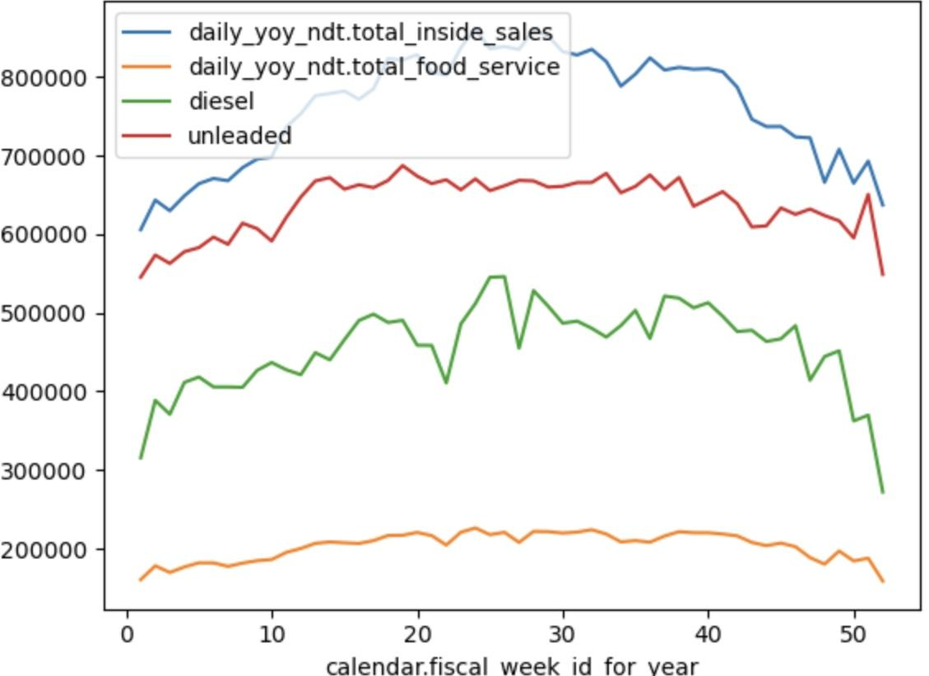
Understanding the Data
Mid-year peak sales.
Year-end sales decline.
Maximum Revenue - Inside Sales
Minimum Revenue - Food Sales

Slide 7
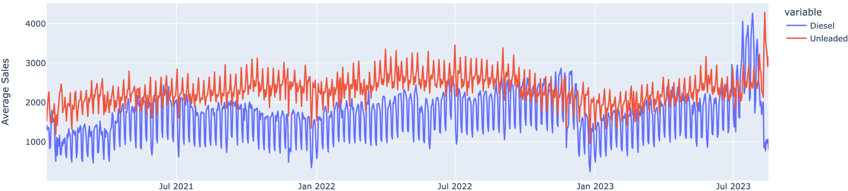
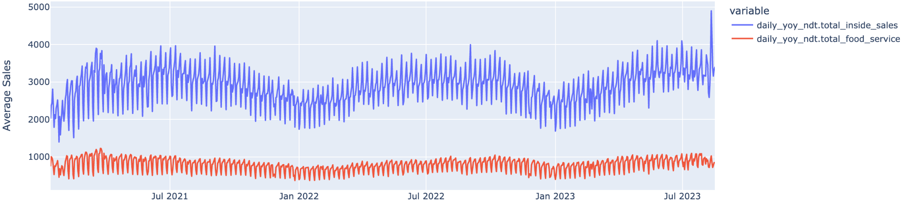
Average Sales Over Time

Slide 8
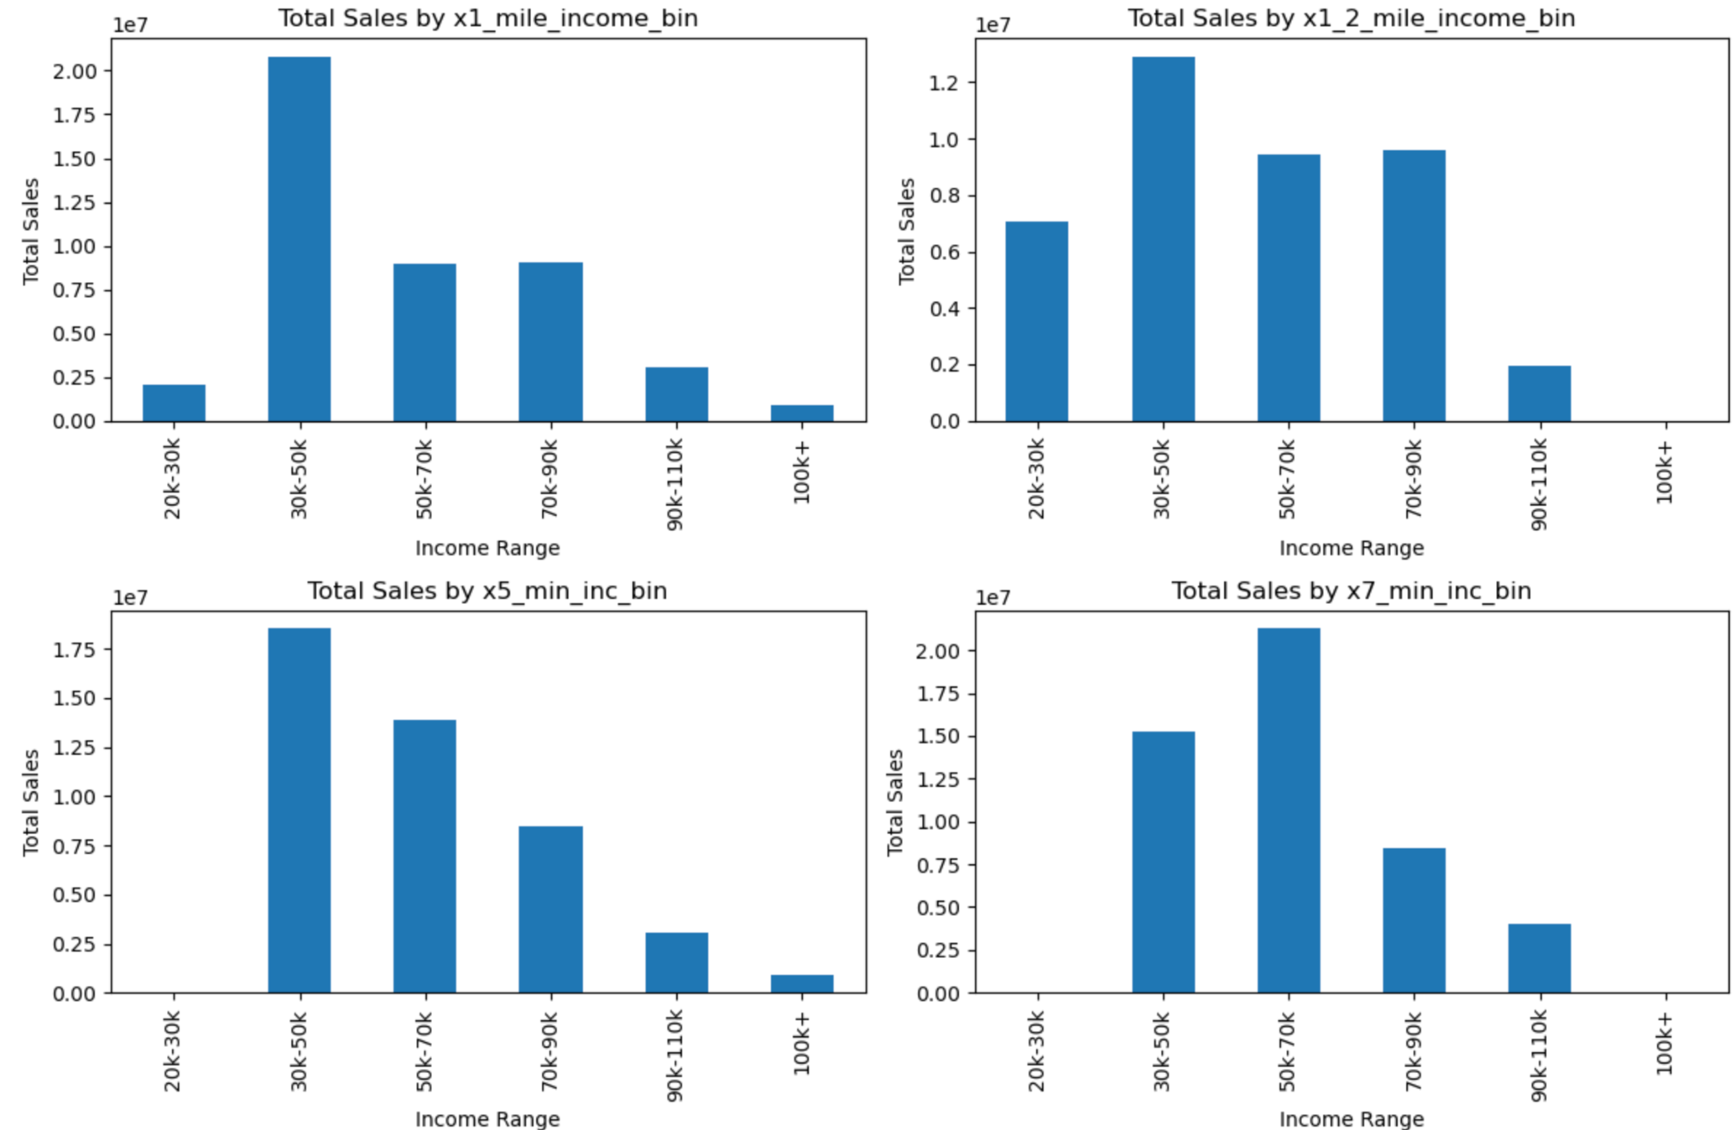
Total Store Sales by Income Type
$30k-$90k earners drive food and inside sales

Slide 9
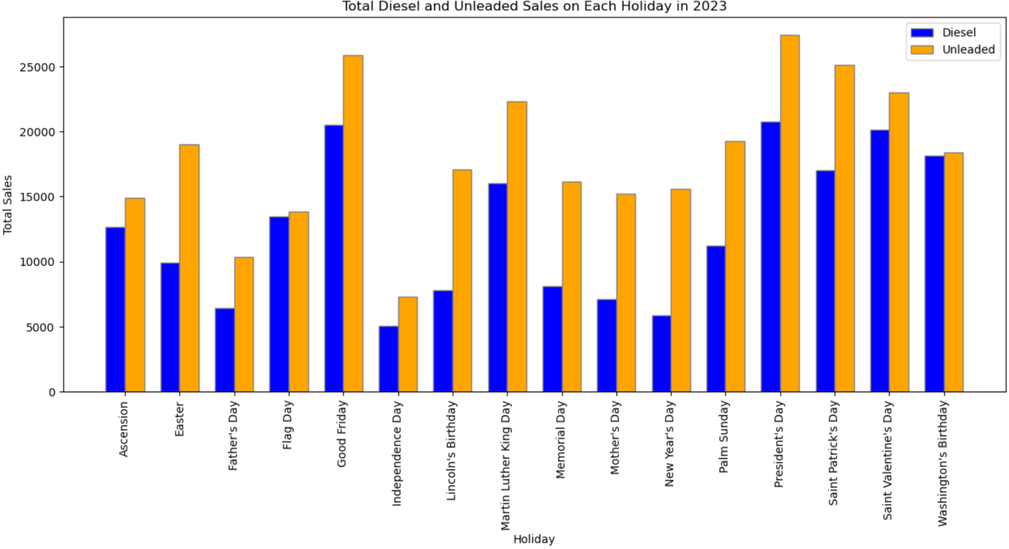
Effect of Holidays on Diesel and Unleaded Sales

Slide 10
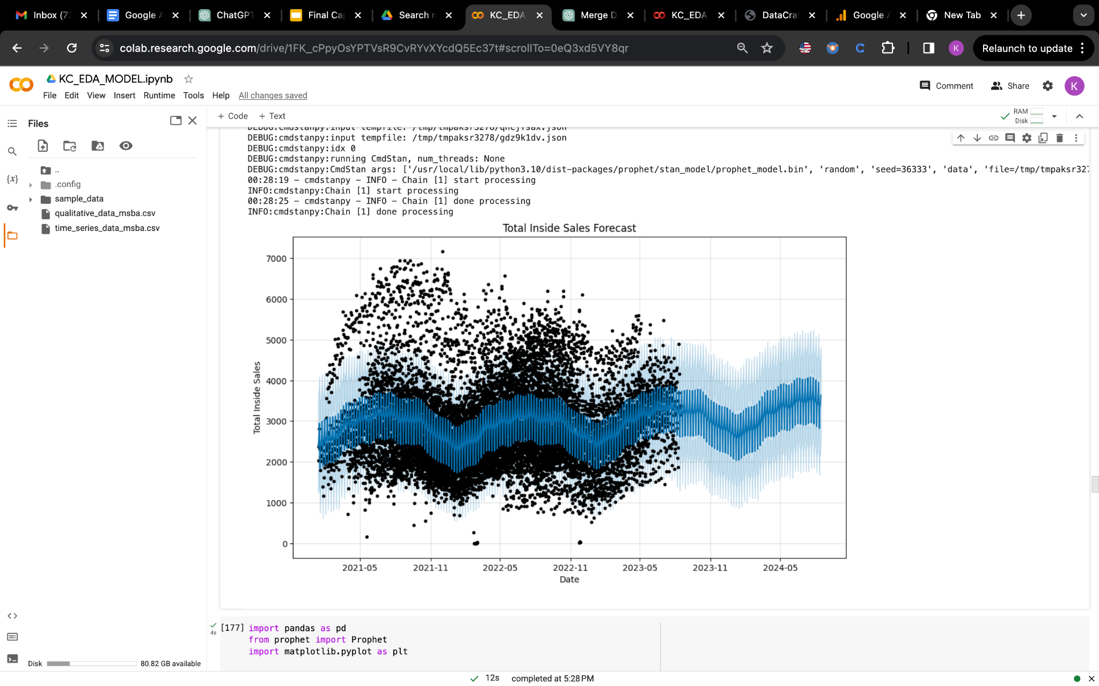
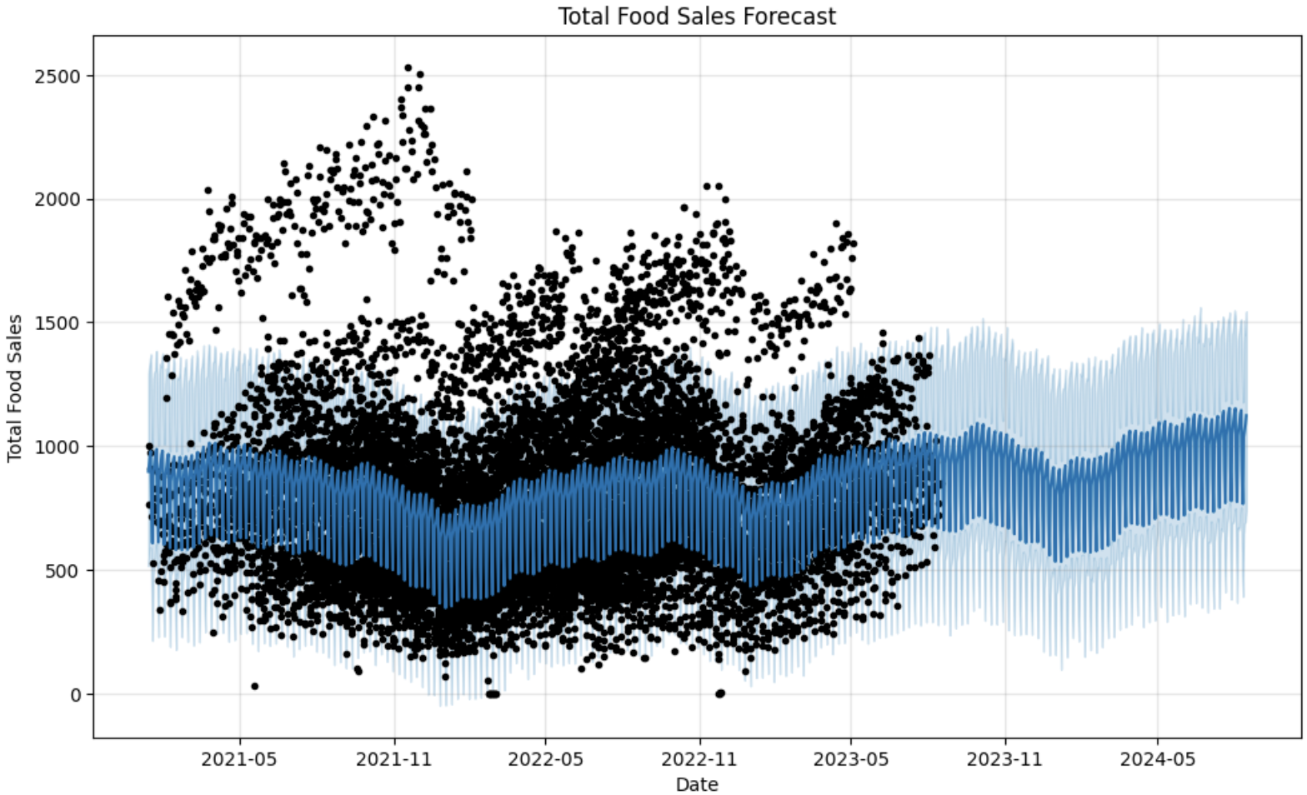
Model Building - Prophet
Inside Sales
RMSE: 1148.6
Food Sales RMSE: 542

Slide 11
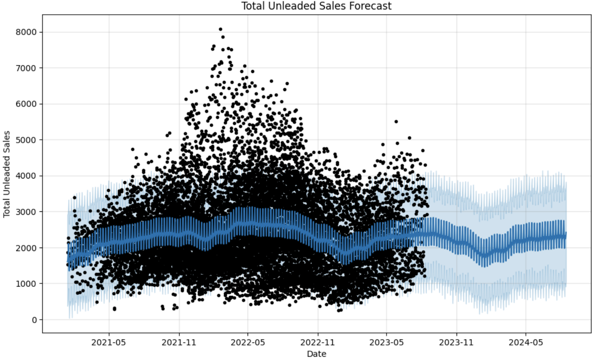
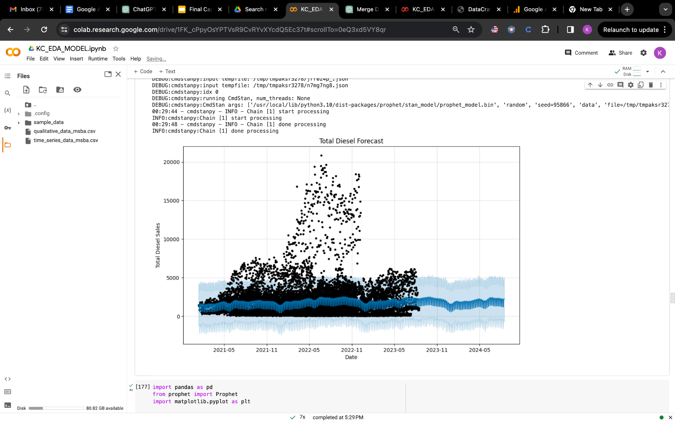
Model Building - Prophet
Unleaded
RMSE: 767
Diesel
RMSE: 5466.9

Slide 12
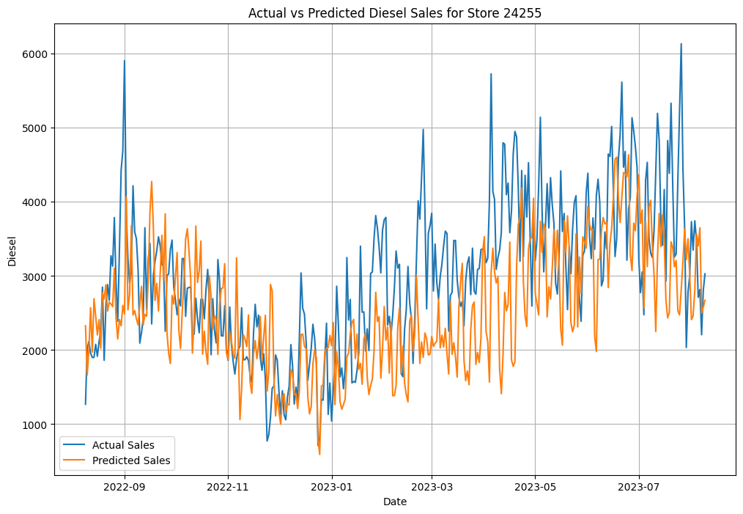
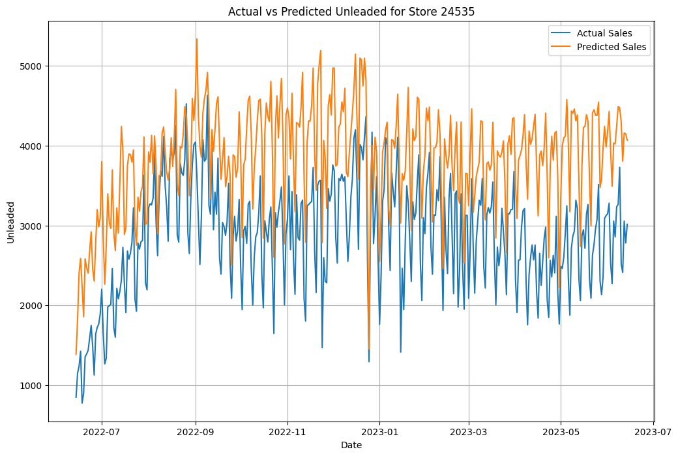
Model- XGBoost Split on Stores
Diesel
Unit RMSE: 1030
Unleaded
Unit RMSE: 1056

Slide 13
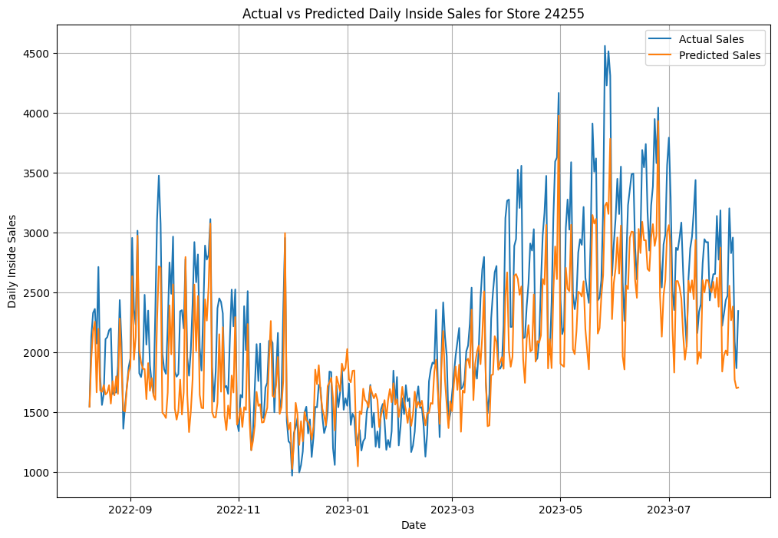
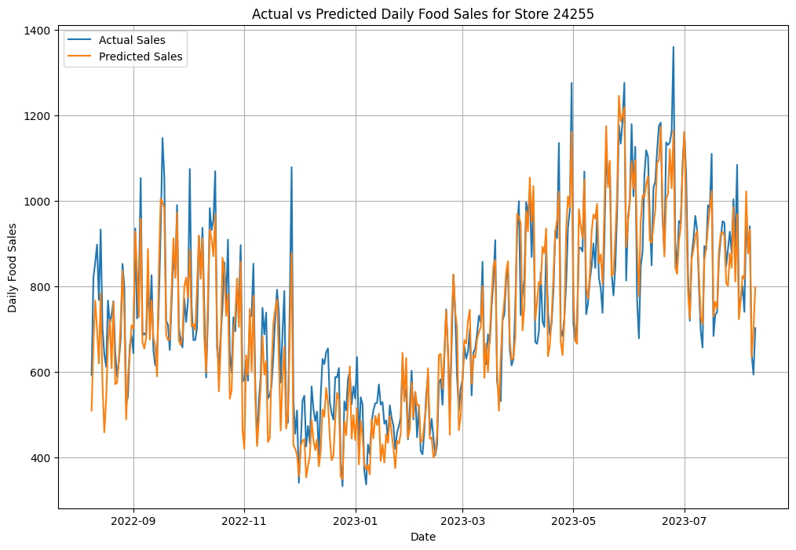
Model- XGBoost Split on Stores
Inside Sales
Unit RMSE: 400.62
Food Sales
Unit RMSE: 102.62

Slide 14
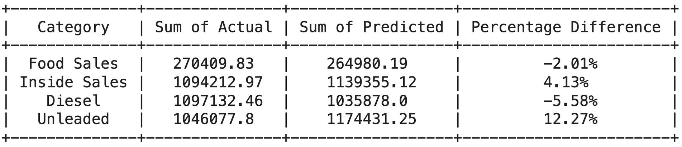
Test Performance

Slide 15
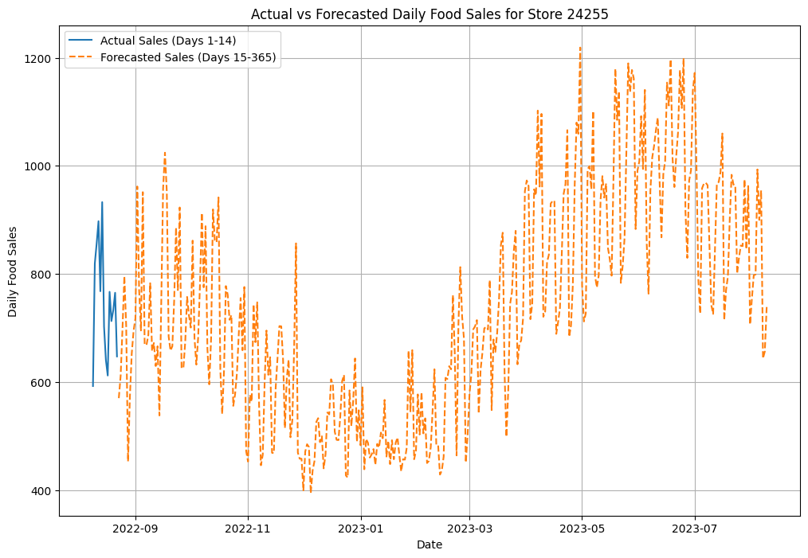
Forecasts Based on Week’s Data
Compared 365 days forecasts for all the targets based off 2, 3 weeks predictions

Slide 16
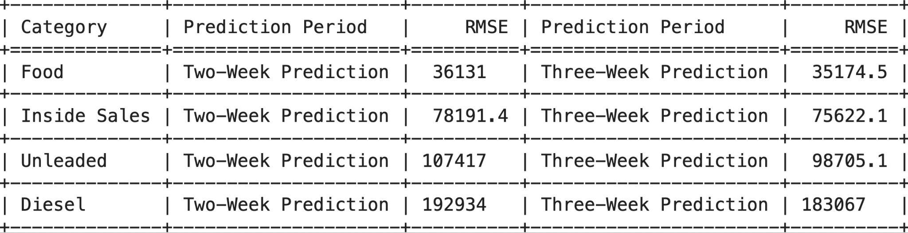
Comparing RMSE

Slide 17
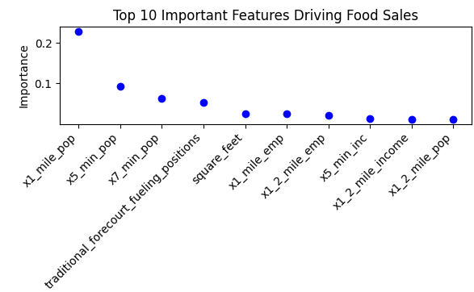
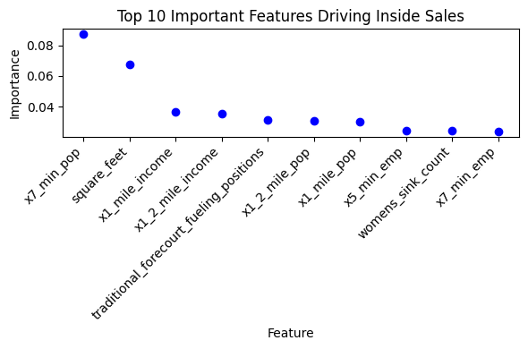
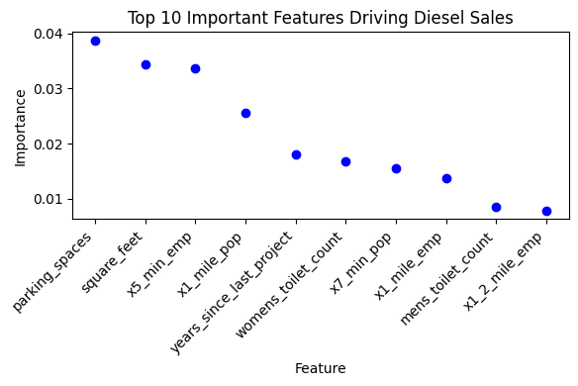
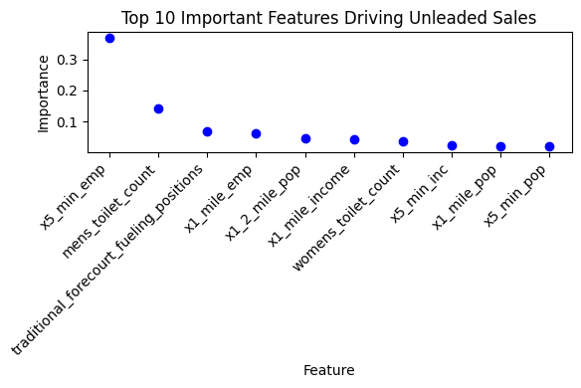
Important Features Driving Sales

Slide 18
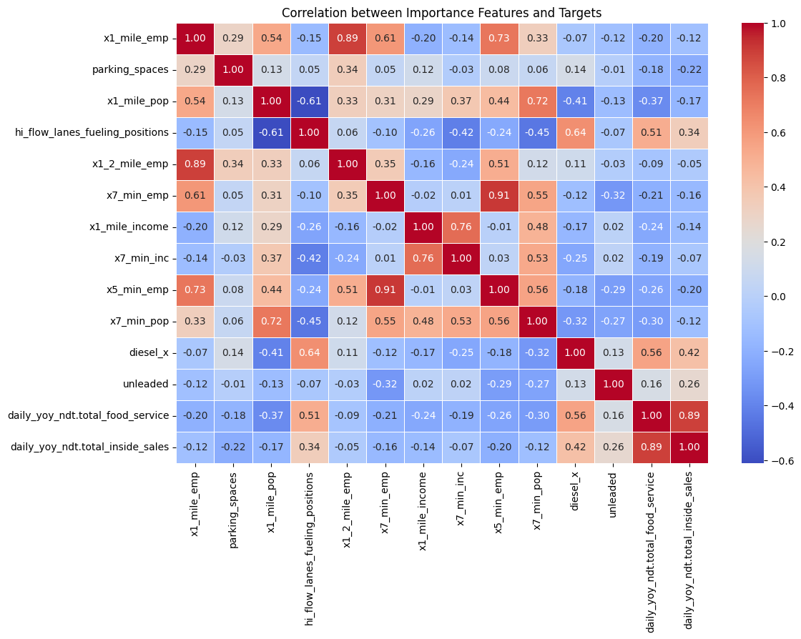
Key Features' Correlation with Targets

Slide 19
Recommendations
Maximum Revenue
Inside Sales
Unleaded
Features :
Employed people living around
Parking Spaces
Facilities easing fueling

Slide 20
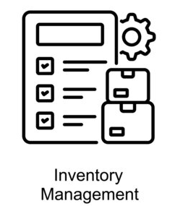


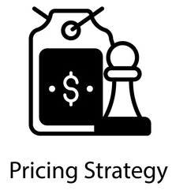
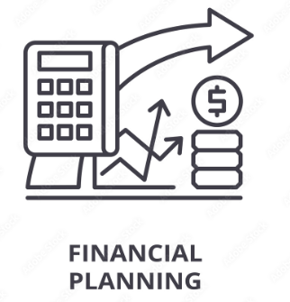
Business Value

Slide 21

Questions

